Slide 1


ANTI-MONEY LAUNDERING
Training Session

Slide 2
What is Money Laundering?
“The concealment of the origins of illegally obtained money, typically by means of transfers involving foreign banks or legitimate businesses”
Money laundering is just one type of financial crime – other types include terrorist financing, bribery and fraud.
The UK economy is the 2nd largest in Europe and as such, is at risk from financial crime!

Slide 3
Legal Rules & Regulatory Requirements
The Proceeds of Crime Act 2002
Terrorism Act 2000
Serious Organised Crime & Police Act 2005
Anti-Terrorism, Crime & Security Act 2001
Serious Crime Act 2007
The Money Laundering Regulations 2017 (inc 2019/2020 amendments)
There are many laws and regulations regarding financial crime and money laundering.
Which of these apply to your firm?

Slide 4
Joint Money Laundering Steering Group
JMLSG is made up of the Financial Services
industry's leading trade associations
The FCA uses JMLSG’s provisions and guidance when deciding whether the
conduct of a firm amounts to a breach of relevant requirements.
Senior Management
Responsibility
Risk-Based
Approach
Internal
Controls
Training
Money Laundering
Reporting Officer
Customer Due
Diligence

Slide 5
Financial Action Task Force (FATF)
An independent intergovernmental
organisation that develops polices to
combat money laundering
& terrorist financing.
FATF was established by the G8 Summit in Paris in 1989 as a
response to the growing concern over global money laundering threats.
34 Members
40 + 9 Special Recommendations

Slide 6
The Money Laundering Process
Placement
The Proceeds of Crime Act 2002 (POCA)
suggests that there are 3 stages
involved in money laundering schemes.
Layering
What do you think
these 3 stages mean?
Integration
Watch 'How Money Laundering Works'

Slide 7
AML Measures & Controls
Regulatory and legal requirement to have anti-money laundering measures, controls and procedures in place.
How Can We Prevent Money Laundering?
Risk Based Approach
Due Diligence Checks
AML Policy & Procedures
Staff Training & Awareness
Governance & Oversight
Money Laundering Reporting Officer
Audits & Monitoring
Record Keeping & Reporting

Slide 8
Risk Based Approach
A risk based approach is a common process used for money
laundering and terrorist funding prevention and encompasses:-
Identification of the Risks
Carrying out Risk Assessments
Design and Implement Controls & Procedures for Risk Mitigation
Monitor Controls to Improve Effectiveness & Efficiency
Good Record Keeping Methods
What are some of the risks and risk areas for your business?

Slide 9
Due Diligence
Taking reasonable care before entering into an agreement or transaction
An investigation onto a person or business to verify their identity, status and history
Research and analysis to determine the accuracy of a statement or situation
Reasonable steps taken by a person or business to avoid committing and offence
Due diligence has multiple definitions, all of which mean protecting
a firm from financial crime and money laundering.

Slide 10
Know Your Customer
Customer due diligence is an essential business activity for
reducing the risks and impact of money laundering.
Monitoring
Identification
Audits
KYC
Background
Evidence
Verification

Slide 11
Policy & Procedures
Anti-Money Laundering Policy
'A firm's statement of intent on how and why they identify,
assess, mitigate, monitor and record money laundering risks'
Where are your AML policy and procedures kept?
Anti-Money Laundering Procedures
'The steps and measures a firm takes to identify, assess, mitigate,
monitor and record money laundering risks and provide staff
with guidance for preventing money laundering'

Slide 12

Staff Training & Awareness
Training is an essential part of preventing money laundering that:-
Provides staff with knowledge and understanding
Helps to keep staff vigilant and aware of the risks
Supports staff in their duties and roles
Meets regulatory and legal requirements
Tests
Workshops
Courses
1-2-1
Intranet
Coaching
Online

Slide 13
Governance & Oversight
Senior management have a responsibility to ensure that
effective controls and procedures are in place within their firm.
UK legislation on money laundering and financial crime places a number
of obligations on firms and their senior management, including:-
To apply Customer Due Diligence measures
To maintain appropriate systems and controls for AML/CTF purposes
To monitor customer transactions and activities
To report suspicious activity, both internally and externally
To keep appropriate records and train staff
To comply with the UK financial sanctions regime

Slide 14
Money Laundering Reporting Officer & Nominated Officer
These terms are often used interchangeably, but for regulated firms, a Money Laundering Reporting Officer (MLRO) is an FCA mandatory requirement and a controlled function.
A Nominated Officer is the person responsible for AML oversight and for making disclosures to the National Crime Agency (NCA) and is a requirement for all firms with MLR obligations.
Use the MLRO Statement Pack and decide which
statements are correct and incorrect when applied
to the Money Laundering Reporting Officer

Slide 15
Audits & Monitoring
Money laundering prevention is not a once only task!
Auditing and monitoring the controls and procedures used to prevent
money laundering is a regulatory requirement.
Checklists
Procedure Audits
Due Diligence Re-checks
Management Information (MI)
Transaction Monitoring
Gap Analysis
Spot Checks
Staff Assessments & Tests
Ongoing Risk Assessments
Updating Procedures & Manuals

Slide 16
Record Keeping
Why is record keeping important?
Firms must retain:-
Copies of evidence obtained of a customer’s identity
for 5 years after the end of the customer relationship
Details of customer transactions for 5 years from the date of the transaction
Firms should also retain:-
Customer Information
Transactions
Internal & External Suspicion Reports
MLRO Annual Reports
Information Not Acted Upon
Training and Compliance Monitoring
Effectiveness of Training Information
Management Information Regarding AML

Slide 17
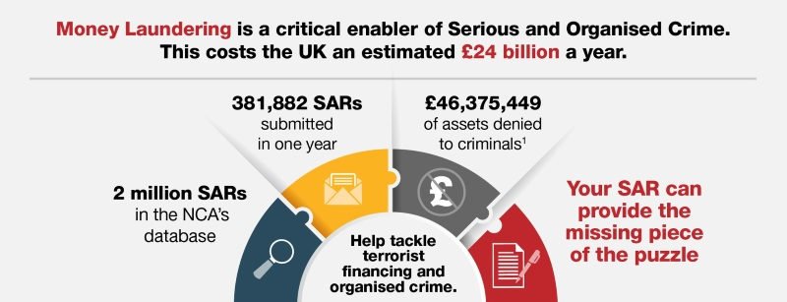
Tipping Off
‘Tipping Off’ is a criminal offence that carries severe
penalties and implications
What is ‘tipping off’?
How can a firm reduce the risk?
What are the penalties of ‘tipping off’?

Slide 18
Reporting & SAR's
If you operate in a regulated sector, you are required to make a report where you:-
know;
suspect; or
have reasonable grounds for knowing or suspecting;
that a person and/or firm is engaged in, or attempting, money laundering or terrorist financing.
A Suspicious Activity Report (SAR) is made to NCA when there is any
suspicion or knowledge of money laundering or a suspicious activity.
Who makes the Suspicious Activity Report?

Slide 19

Supervisory Authority
Those with MLR17 obligations
must be monitored by a
Supervisory Authority
FCA
HMRC
The Gambling Commission
Professional Body
Who is your Supervisory Authority?

Slide 20
Q&A

